Slide 1
Automotive Battery Thermal Runaway Prediction: EIS Project
Robert Tan & Dr. Wesley Poh
Automotive Division – Global Systems Team
Infineon Technologies Asia Pacific Pte Ltd

Slide 2
Objectives
The primary objective is to conduct rigorous testing to gather datasets for developing a predictive model capable of identifying early warning signs (precursors) of thermal runaway in lithium-ion cells before catastrophic failure occurs. The project will utilise controlled battery cycling to induce degradation and capture high-resolution electrochemical data for analysis, as elaborated below.
i) Experimental Set-Up and Safety
- Test Bench Construction: Set-up of battery cyclers (Chroma & NGI) and environmental chambers.
- Sensor Integration: Installation of thermocouples, voltage sensors, and strain gauges (if monitoring swelling) on target cells.
- Safety Protocols: Implementation of containment vessels and fire suppression systems to manage intentional or accidental thermal events during testing.
ii) Data Generation (Cycling Regimes)
- Baseline Characterisation: Perform initial capacity and impedance checks on fresh cells.
- Accelerated Aging: Subject cells to high C-rate cycling and elevated temperatures to accelerate degradation.
- Abuse/Trigger Testing*: Apply controlled overcharge or overheating protocols to push cells toward the “onset” of thermal runaway, capturing near-failure data. *Constraint: Testing will cease immediately upon detection of thermal runaway initiation (venting or rapid temperature rise) to preserve data integrity.
iii) Data Analysis and Modelling
- Extract key features from raw battery data, such as coulombic efficiency trends, differential voltage analysis, and temperature rate of change. These will be used to develop machine learning learning models for predicting thermal runaway precursors.

Slide 3
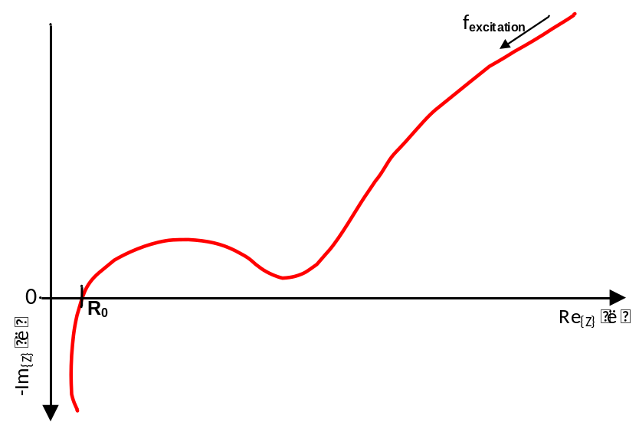
Nyquist plot from EIS (electrochemical impedance spectroscopy)
Impedance spectrum of a Li-Ion battery vs frequency coverage
Relation – Impedance spectrum vs EIS use case
mHz range
Relevant for SoX*
SoH
High Hz range
Low Hz range
Mid Hz range
higher Hz range
Lower Hz range
mid Hz range
Temp
SoC
Power
*Depending on cell chemistry, structure,
use case, etc.
*Depending on cell chemistry, structure,
use case, etc.
mHz till Low Hz range
  Gen1 EIS TLE9012DQU
mHz till Mid Hz range
  Gen2 EIS TLE9018DQK
Higher frequencies
  Gen3/4 EIS TLE9024DQK/TLE90xxEQK
The higher the impedance frequency, e.g., 1 kHz, the more crosstalk effects of the wiring of the battery cell itself are overlaying the measurement.
SoH is the source for SoC algorithm calibration over aging and power estimations. Hence, EIS implementation for SoH is valuable.

Slide 4

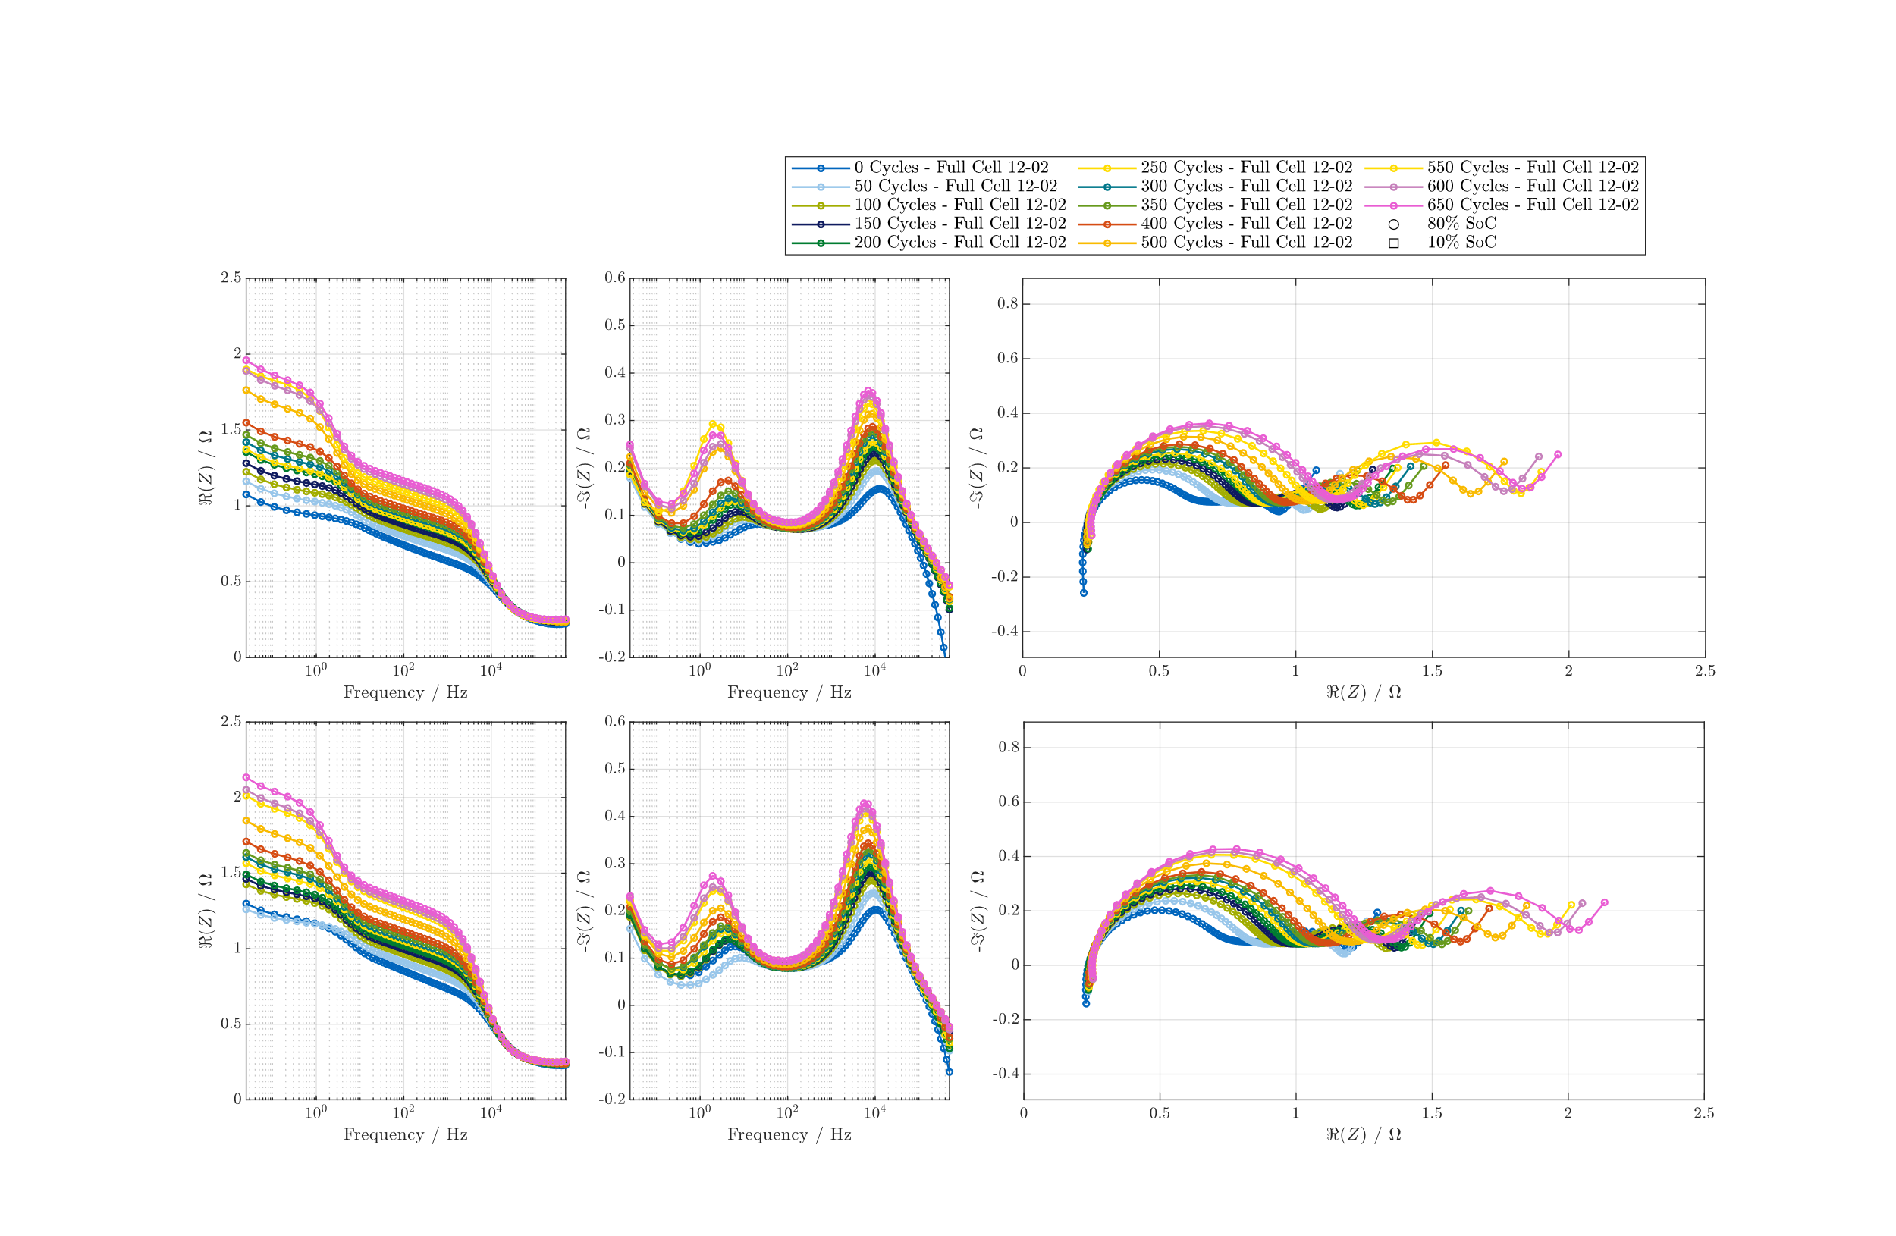
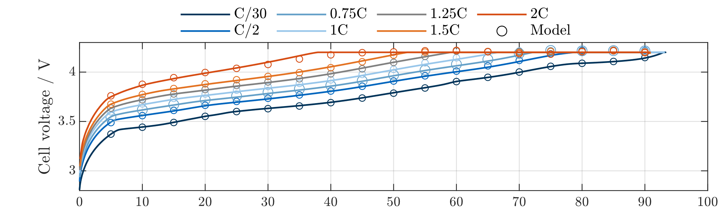
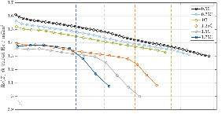
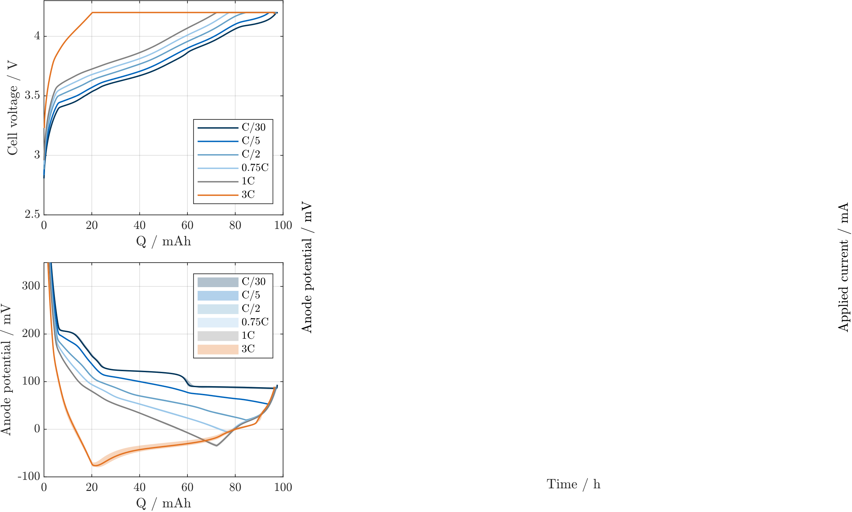
Using EIS data from aging cells
From aging data to model…
Characterisation of cells
in frequency and time domain
Model parameterisation and algorithm development
Measured vs. simulated CC/CV charge profiles to validate electrochemical model
Cycling aging tests with EIS meas. during reference performance tests (RPTs)
Detection of safety critical lithium plating side reaction with EIS
Aging tests on NMC cells aim to identify aging-sensitive cell parameters via EIS.
Validation of a real-time model running on AURIX.
Detection of lithium plating using EIS.

Slide 5


Types of EIS in HV batteries and our available solutions
Pack-Level EIS
Cell-Level EIS
Requires V/I sensing of the pack only.
Typically performed by the pack montoring IC.
Typically performed for intercept-point (typically high Hz) ranges for estimating State-of-Power.
PSOCTM SPM
Requires V/I sensing of every individual cell.
Can be performed using single-channel AFE, multi-channel AFE, or highly synchronous AFEs.
Typically performed for mHz to mid-Hz ranges due to challenging cross-talking and magnetic coupling.
TLE90xx
R1
1
V_{dd}
Excitation
Circruit
R_{sense}
2
PWM
Current
Excitaion
1
R2
AC decoupling
circuit
3
V_{sense}
2
V_{sense}
4
3
I_{sense}
I_{sense}
4
R_{sense}
5
R_{load}
6
5
Available Infineon Solutions:
PSOCTM SPM: Pack monitoring IC with High-Voltage Precision Analog and capability to measure up to 10 kHz pack EIS.
Available Infineon Solutions:
TLE9010: Single-channel EIS with AC-decoupled ADC and capability to measure up to 7 kHz EIS.
TLE9018 + PSOCTM HVPA: Synchronous EIS measurement with Iso UART (up to 333 Hz).

Slide 6
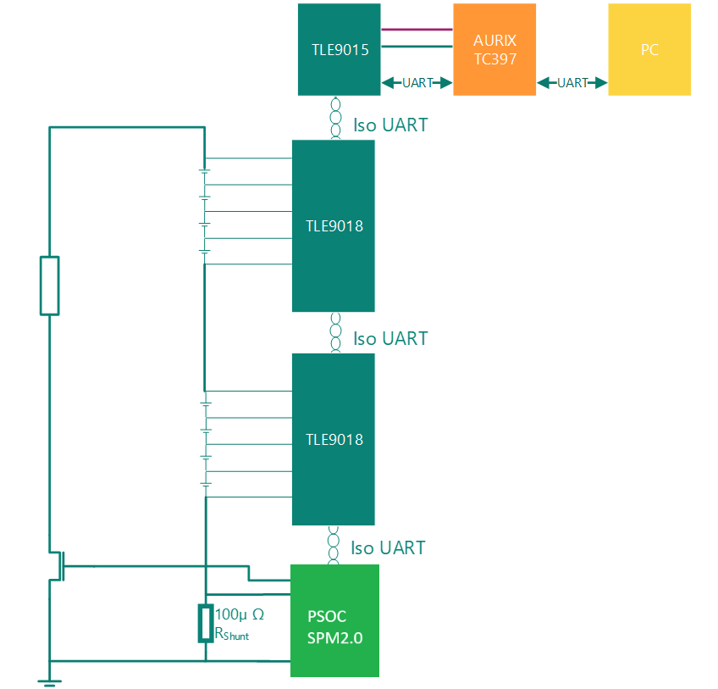
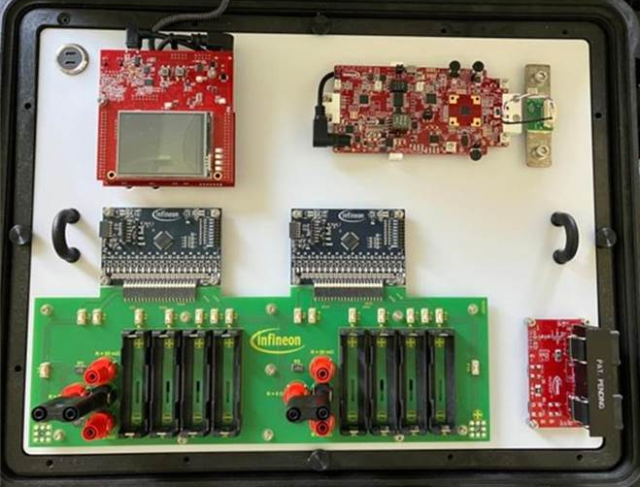
EIS Demo
1
Trigger measurement
2
Perform synchronous
V and I measurement
3
Read results and compute EIS

Slide 7
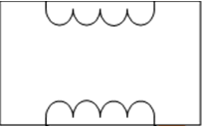
High-Voltage (HV) BMS
HV+
Vpack
AFE 1
(TLE901x)
VCU
PMIC
CMU1
- +
5V
AFE 2
(TLE901x)
- +
CMU2
- +
Microcontroller
Microcontroller
UART/SPI
Isolation
Transciever
AFE 3
(TLE901x)
- +
CMU3
CAN
AFE 4
(TLE901x)
CAN
CAN Transceiver
CAN Transceiver
CMU4
- +
AFE 5
(TLE901x)
- +
BMU
CMU5
- +
AFE 6
(TLE901x)
- +
CMU6
SOx pack = F(Vpack, Ipack, T)
AFE n
(TLE901x)
- +
CMU n
- +
CAN
Pack Monitoring IC
Shunt
lpack
PMU
HV-

